Slide 1

Ancient Bharat and Science
Decodinghinduism.com
Notes:
Science and technology of Ancient India. A glimpse.

Slide 2
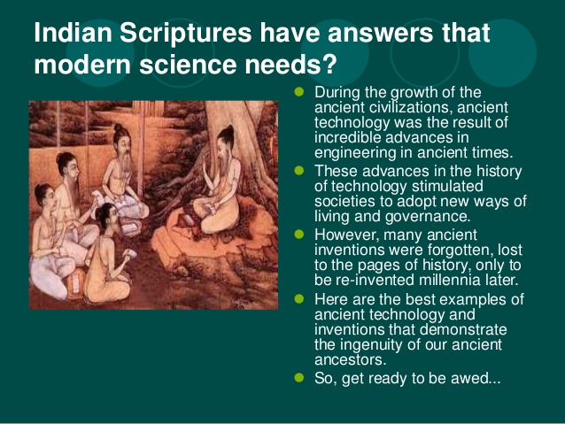

Decodinghinduism.com

Slide 3
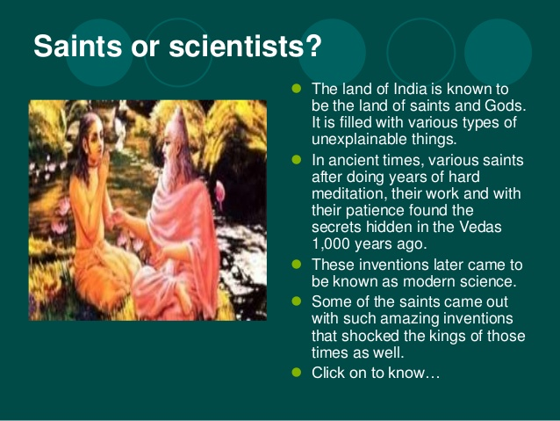

Decodinghinduism.com

Slide 4
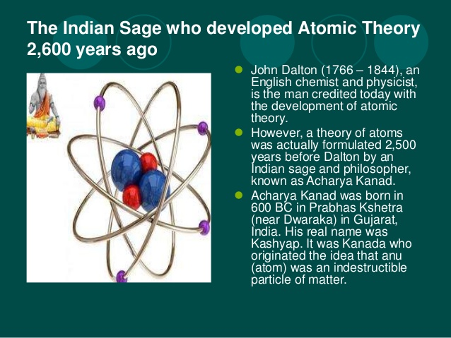
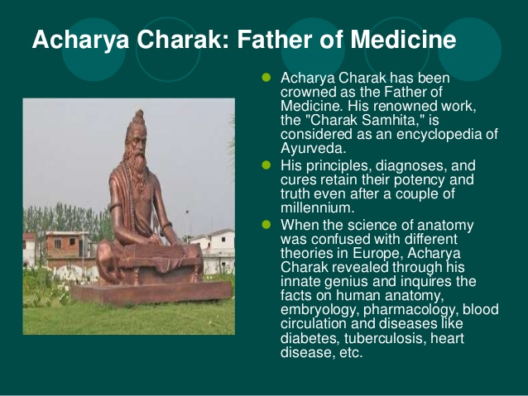
Decodinghinduism.com

Slide 5
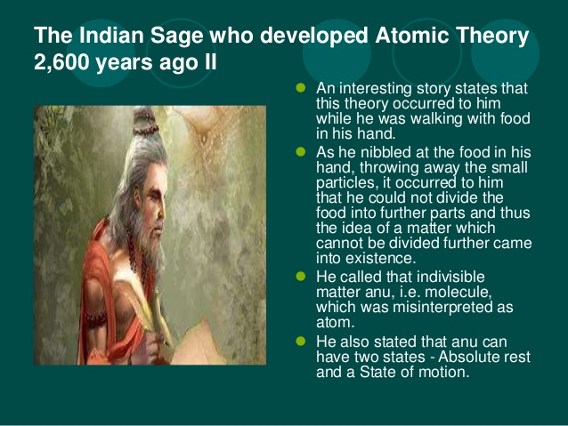

Decodinghinduism.com

Slide 6
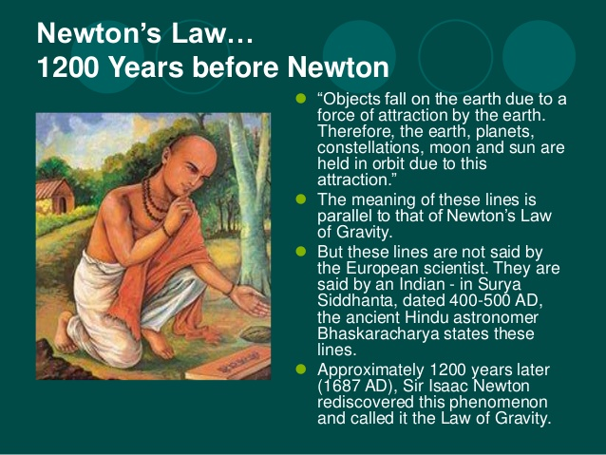

Decodinghinduism.com

Slide 7

Decodinghinduism.com

Slide 8
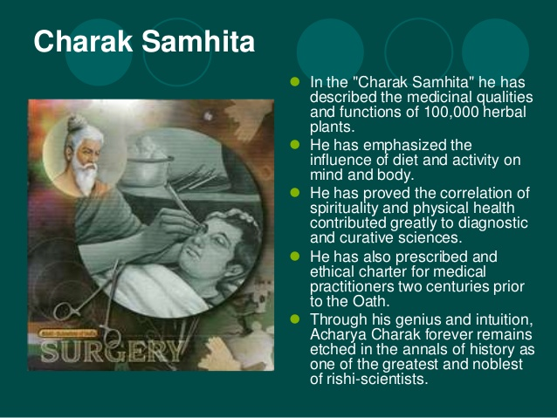

Decodinghinduism.com

Slide 9
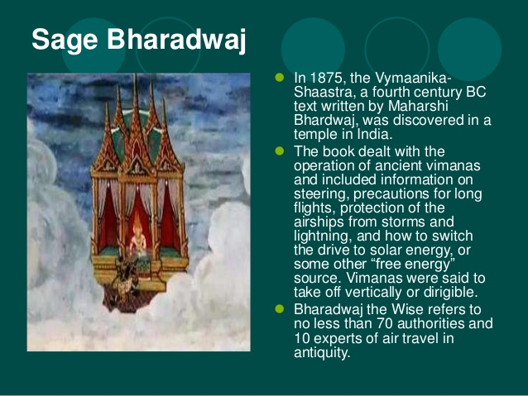
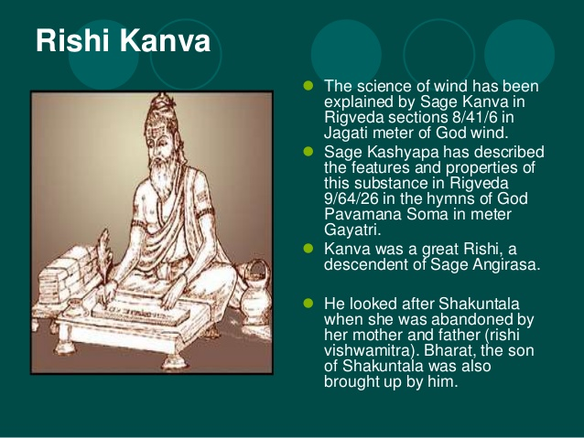
Decodinghinduism.com

Slide 10



Slide 11
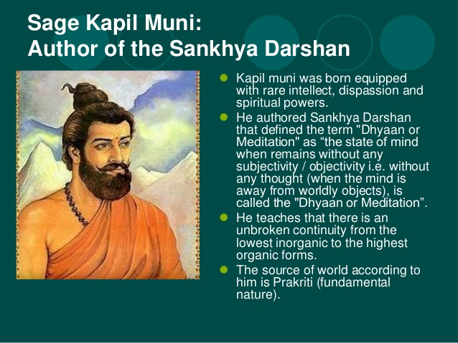

Slide 12
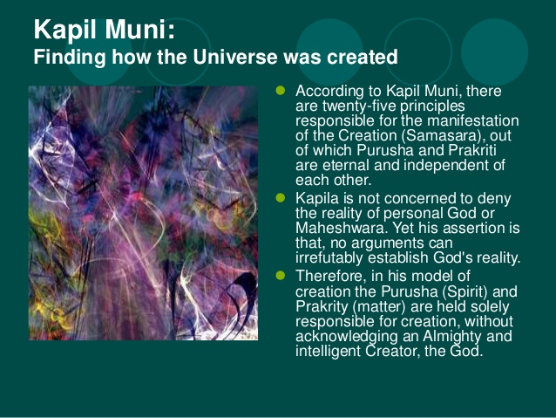

Decodinghinduism.com

Slide 13
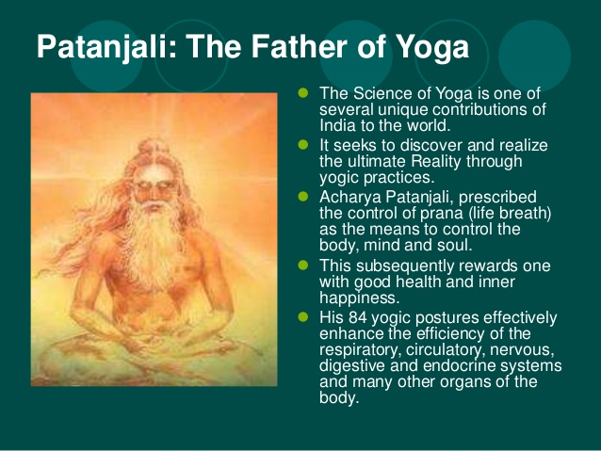

Slide 14
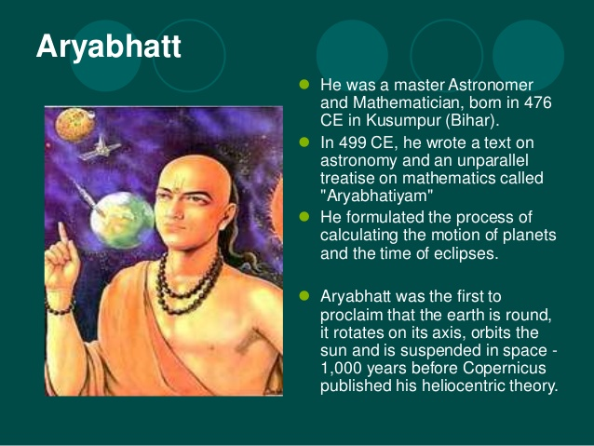


Slide 15
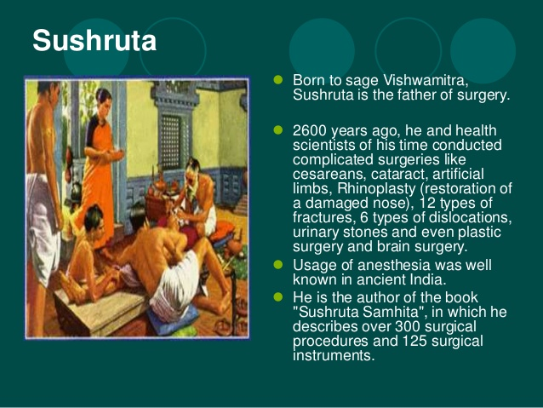
Decodinghinduism.com

Slide 16
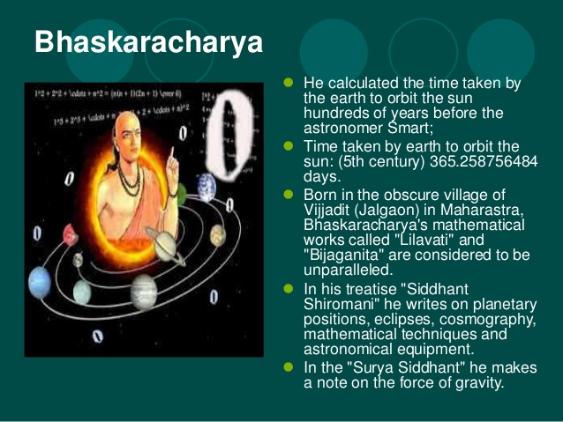


Slide 17
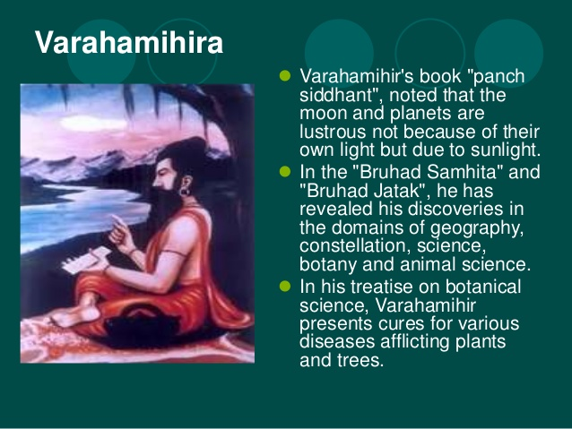

Decodinghinduism.com

Slide 18
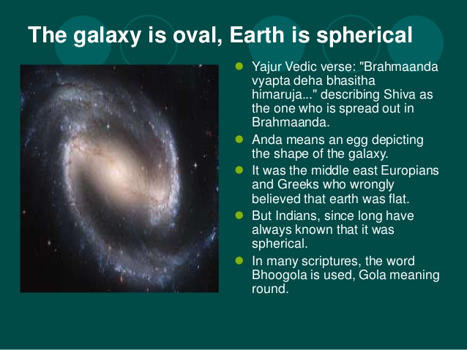


Slide 19
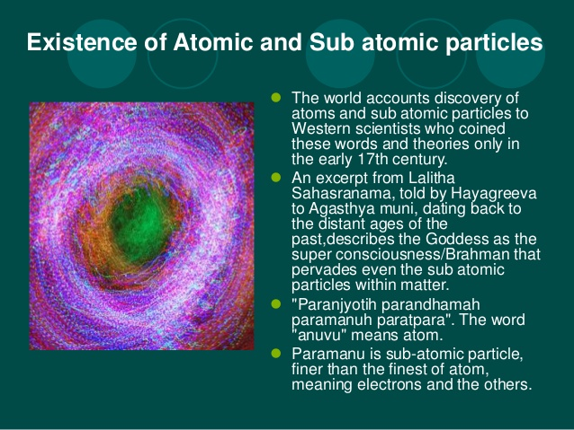


Slide 20
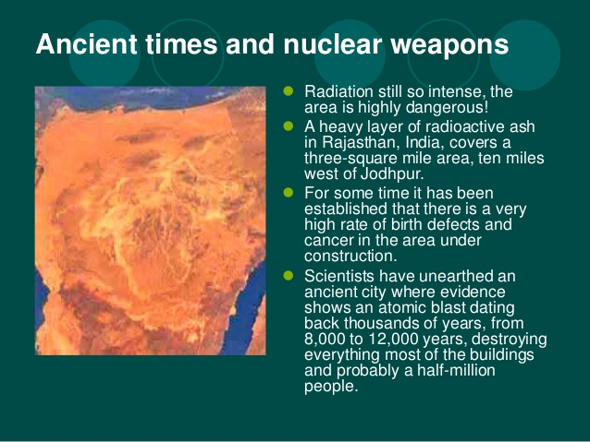

Decodinghinduism.com

Slide 21
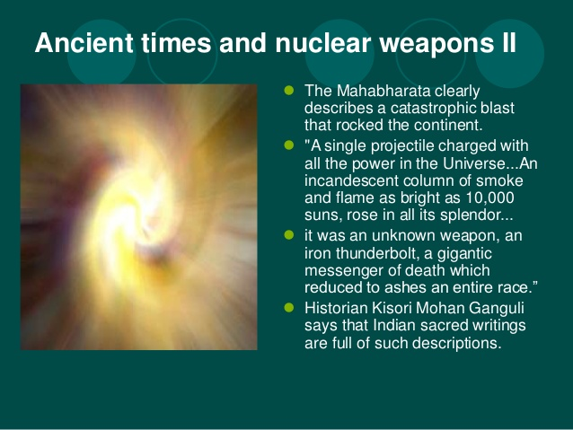


Slide 22
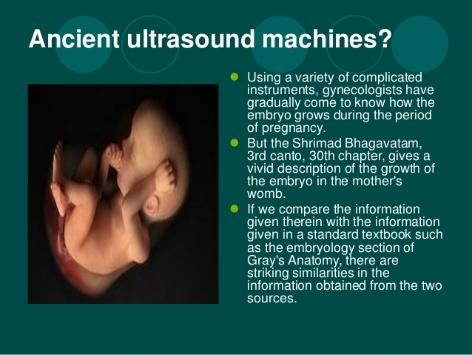


Slide 23
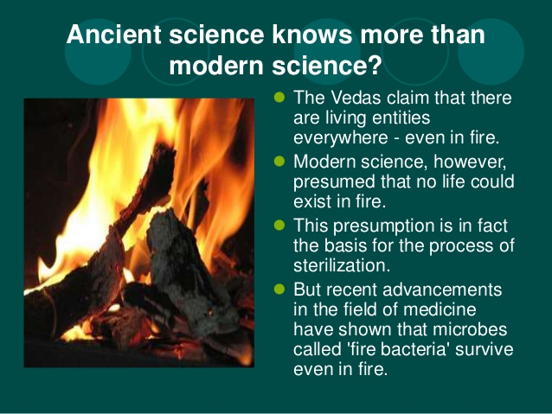


Slide 24
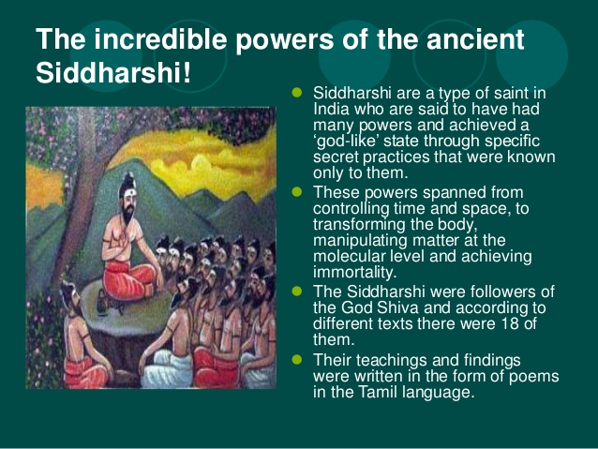

Decodinghinduism.com

Slide 25
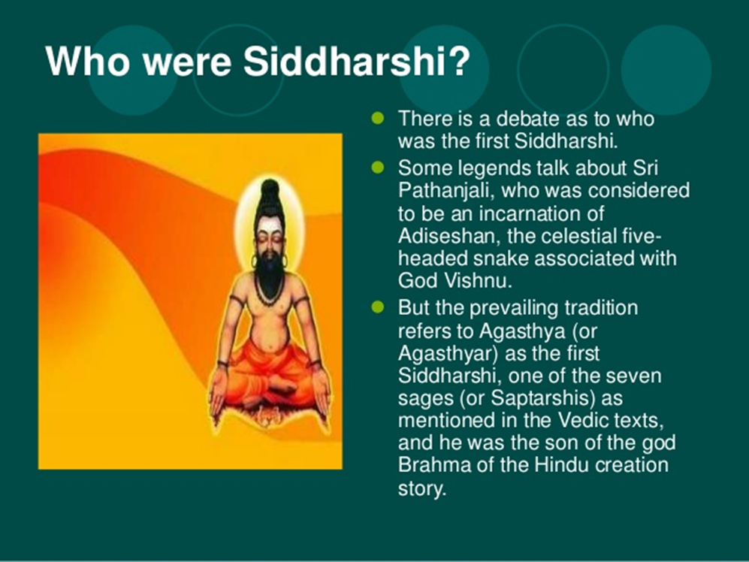

Slide 26
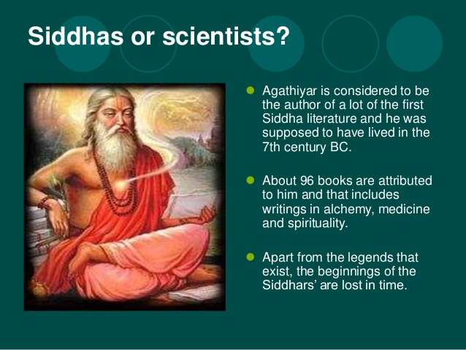


Slide 27
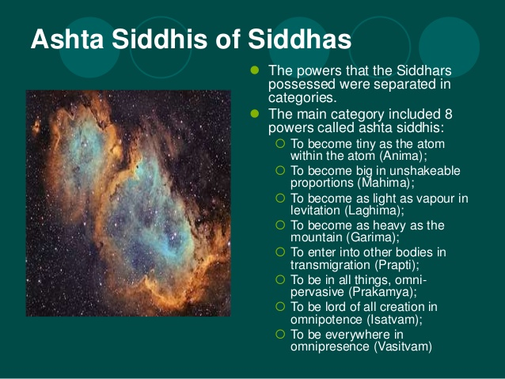

Slide 28
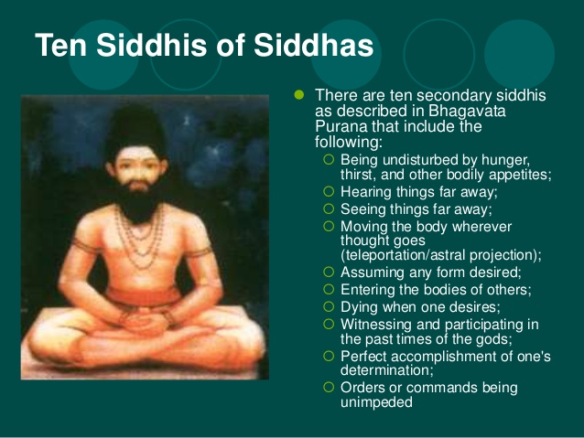

Decodinghinduism.comhttp://WWW.EAYURVEDA.ORG

Slide 29
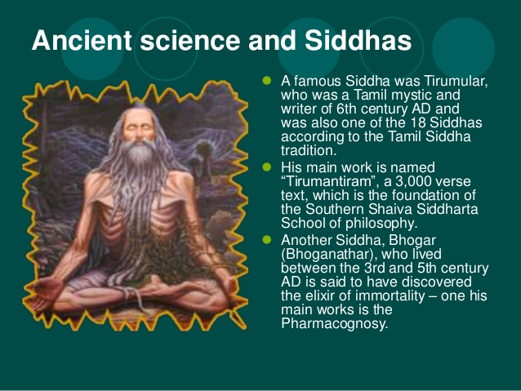

Slide 30
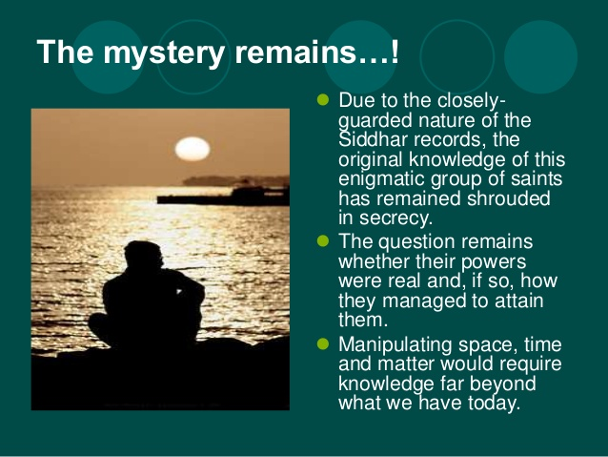
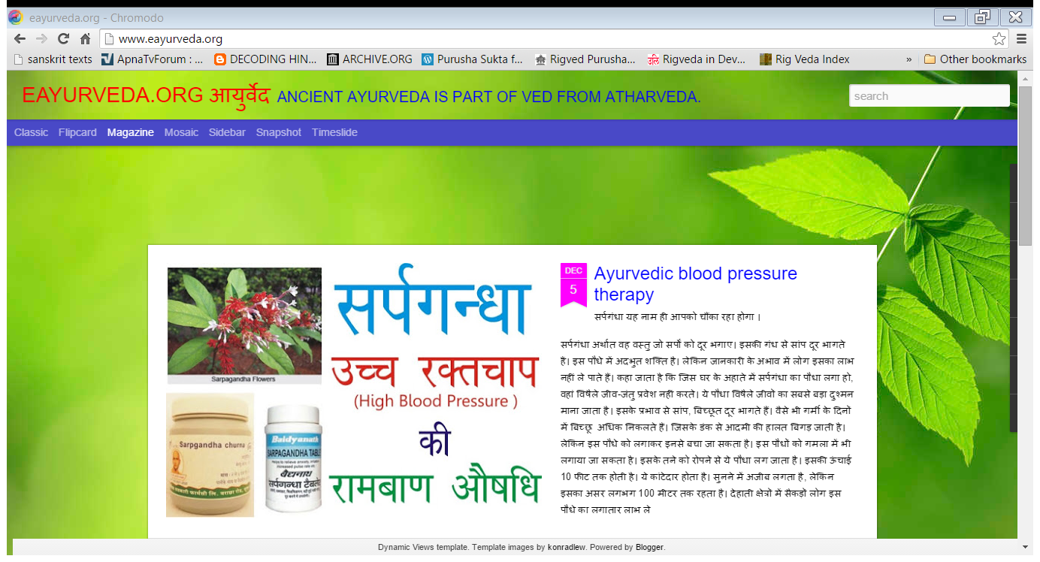


Slide 31
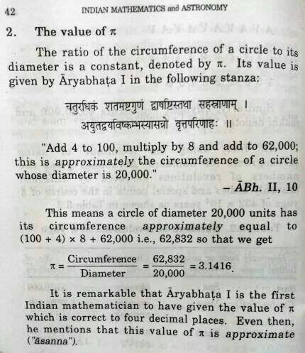
Value of Pi written in Sanskrit by Arya Bhatta, long before any European thought of it.

Slide 32

Embryology in Yajurved

Slide 33
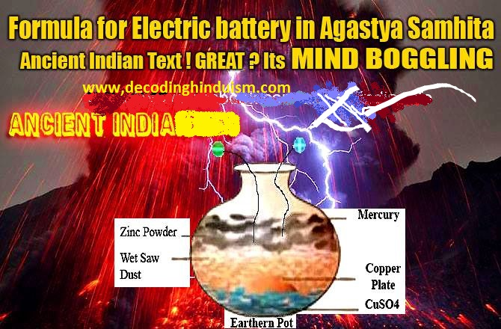
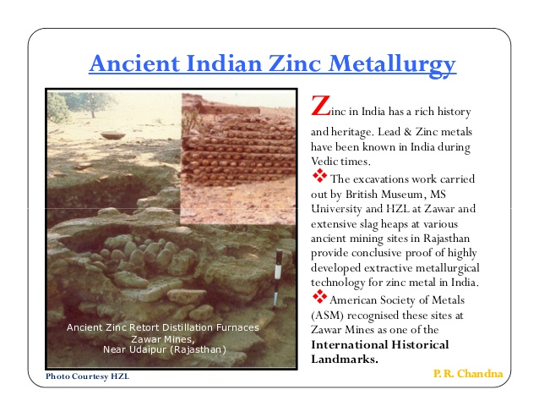

Slide 34
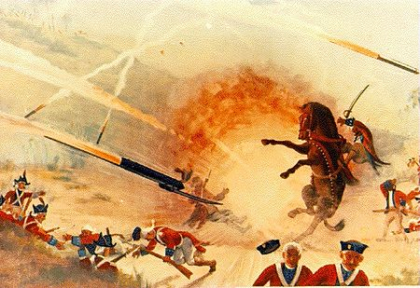
Mysore Rockets
Mysore Rockets
Mysore rockets were the first iron-cased rockets successfully deployed for military use. Hyder Ali, used them effectively against the British. British used this technology, to advance European rocketry with the development of the modern rockets.

Slide 35
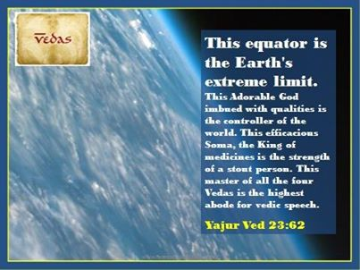
Equator of earth in Ved

Slide 36
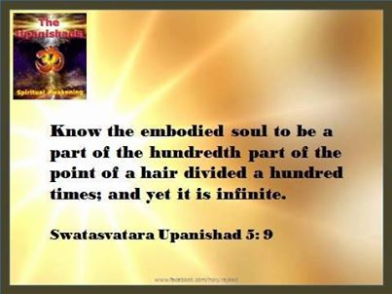
Upnishad knows about Soul?
Decodinghinduism.com

Slide 37
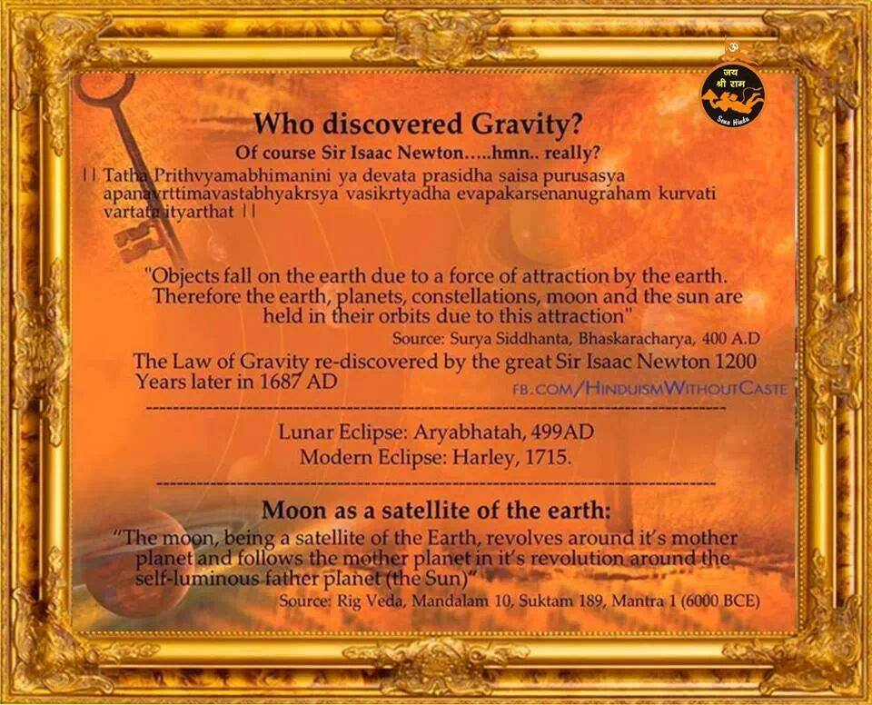
Gravity discovered by Newton-Rethink

Slide 38
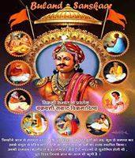
Maharaja Vikramaditya

Slide 39

<iframe width="420" height="315" src="https://www.youtube.com/embed/OIV_W5jRMOw" frameborder="0" allowfullscreen></iframe>

Slide 40
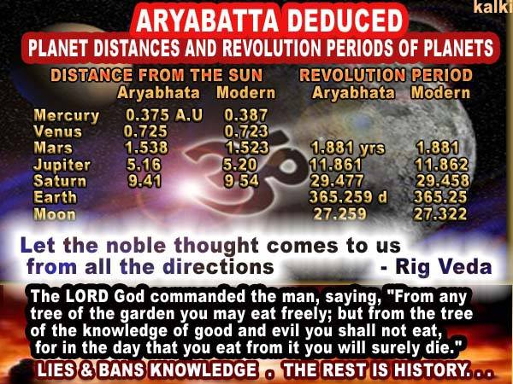

Slide 41
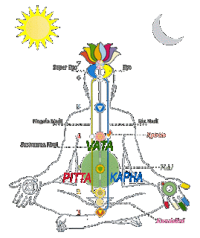
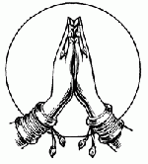
Ayurved

Slide 42
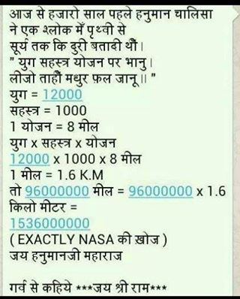

Hanuman Chalisa –Earth-Sun
Decodinghinduism.com

Slide 43
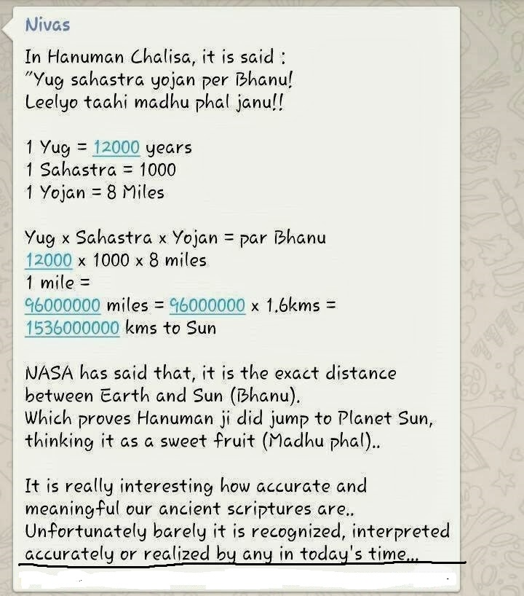
Hanuman Chalisa-Earth-Sun
Decodinghinduism.com

Slide 44
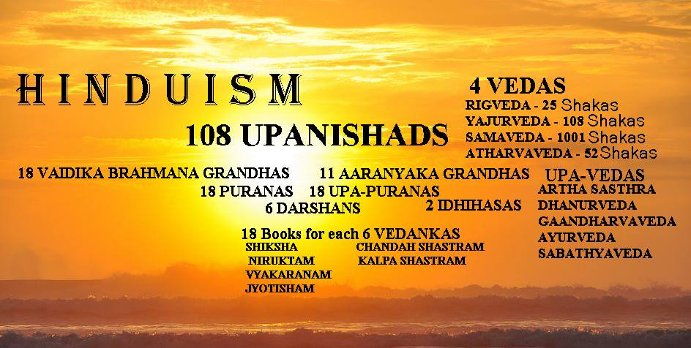
Hinduism,Upnishad,Vedas
Decodinghinduism.com

Slide 45

Speed of Light in Rigved
Decodinghinduism.com WWW.PPARIHAR.COM WWW.SANSCRITUM.COM

Slide 46
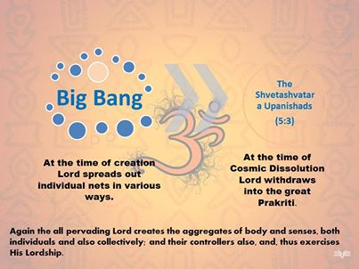
Big bang theory and Upnishad
Decodinghinduism.com

Slide 47
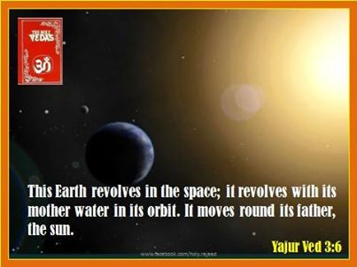

Yajurveda- Earth<->Sun

Slide 48




Slide 49
More At
WWW.PPARIHAR.COM
WWW.DECODINGHINDUISM.COM
WWW.SANSKRITUM.COM
WWW.VEDICBHARAT.ORG
WWW.SHANKHNAD.ORG

Slide 50
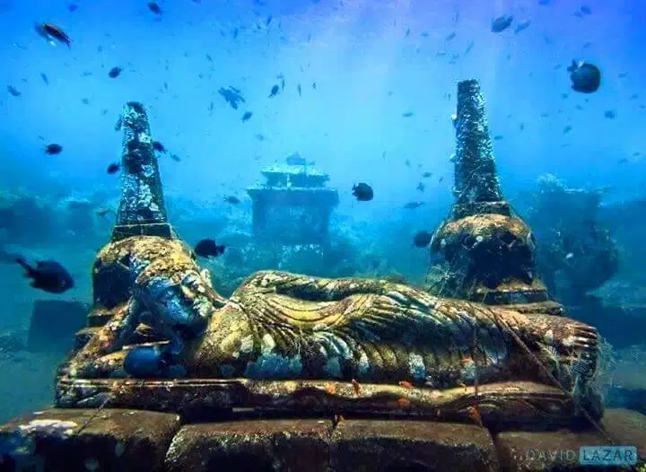
>5000 Yr Old God VISHNU in Bali

Slide 51

Ancient Hindu Technology

Slide 52
HINDUISM -- SCIENTIFICALLY proven RELIGION (Full)

